Slide 1

Next-Generation Capabilities for Large-Scale Scientific Visualization
SIAM Conference on Parallel Processing for Scientific Computing
February 15, 2012
Kenneth Moreland, Nathan Fabian
Sandia National Laboratories
Berk Geveci, Utkarsh Ayachit James Ahrens
Kitware Inc. Los Alamos National Laboratory
SAND 2012-0754 P
Sandia National Laboratories is a multi-program laboratory managed and operated by Sandia Corporation,
a wholly owned subsidiary of Lockheed Martin Corporation, for the U.S. Department of Energy’s National
Nuclear Security Administration under contract DE-AC04-94AL85000.

Slide 2
Collaborators
Sandia National Laboratories
Kenneth Moreland
Nathan Fabian
David Thompson
Ron Oldfield
Los Alamos National Laboratories
James Ahrens
Jonathan Woodring
Oak Ridge National Laboratory
Scott Klasky
Norbert Podhorszki
Argonne National Laboratory
Venkatram Vishwanath
Mark Hereld
Michael E. Papka
Kitware, Inc.
Berk Geveci
Utkarsh Ayachit
Andrew C. Bauer
Pat Marion
Sebastien Jourdain
David DeMarle
University of Colorado at Boulder
Michel Rasquin
Kenneth E. Jansen
Rutgers University
Ciprian Docan
Manish Parashar

Slide 3
Outline (Hide)
Overview history: Onyx to Exascale
ParaView
General capabilities
Remote visualization
In situ
Workflow, In transit
Exascale challenges
What changes
Dax

Slide 4
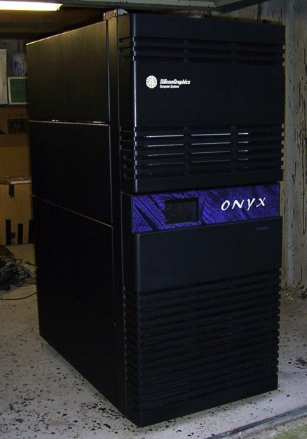
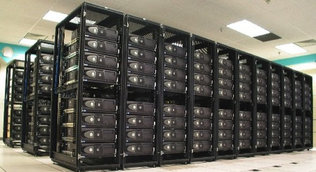
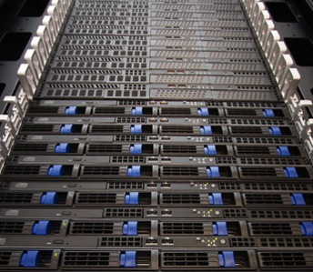
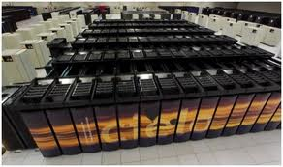
1990’s
2000’s
2020’s
Before consumer market impacted graphics. Single memory/multipipe machines (SGI)
2005: Specialized Vis cluster - Distributed memory, commodity clusters tightly coupled with compute platform.
Specialized HW (graphics cards, I/O, memory)
2010: Distributed memory capability clusters – ‘Running on the platform’
Highly constrained memory, no specialized HW
Constrained by power
Need: Coupled analysis
Exascale breaks everything
New programming models
Billion-way parallelism
RedRoSE/BlackRoSE
Exascale
Platform
Cielo
Notes:
I work with a group at Sandia that has spent over a decade addressing large-scale high-performance computing.
Our analysis involves simulation results from some of the worlds largest supercomputers.
The early work of our group used refrigerator-sized, special-purpose graphics workstations like this SGI Onyx.
Late ‘90’s, early 2000’s cheap consumer graphics overtook expensive special-purpose graphics hardware.
Represented a disruptive change of technology.
Needed way to “scale up” consumer products.
Built clusters like BlackRoSE. (Comprises normal Dell desktops lying on side stuffed in rack. At time no vendor had rack mounted blades that accepted graphics cards.)
Needed new software solutions to drive new distributed memory computers.
I’ll summarize 10-years worth of HPC visualization research in about 10 minutes.

Slide 5
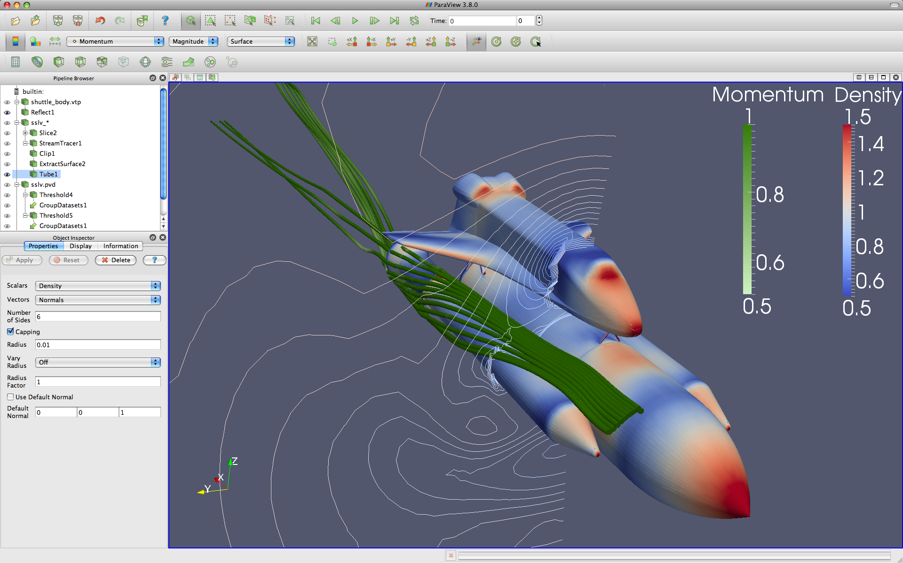


ParaView: an End User Tool for Large-Scale Visualization
http://paraview.org
Notes:
We’ve taken all these HPC visualization tools and incorporated them into an end user tool called ParaView.
A general purpose scientific visualization tool.
ParaView is used by thousands of people worldwide.
It’s free. You can go to paraview.org to download a copy today.

Slide 6
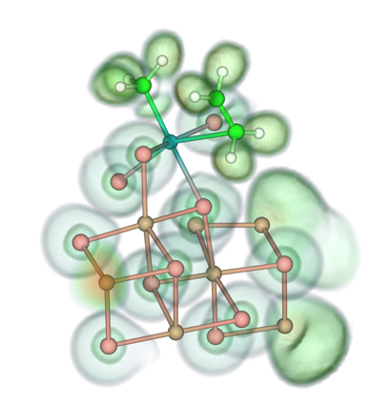
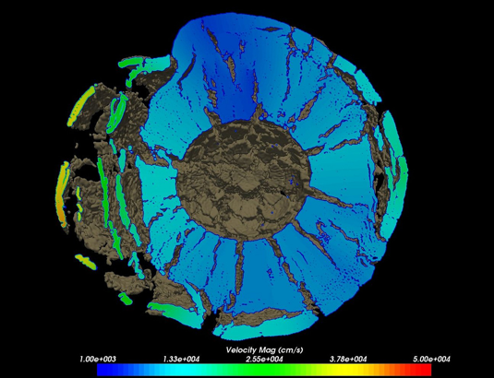
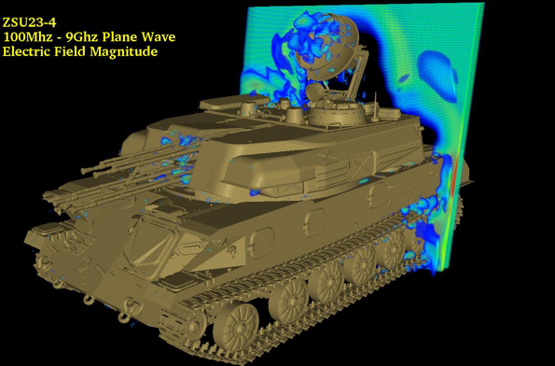
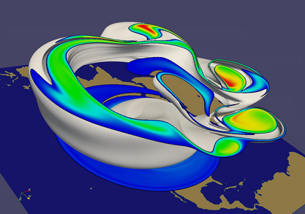
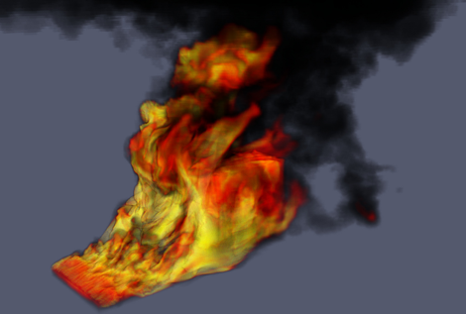
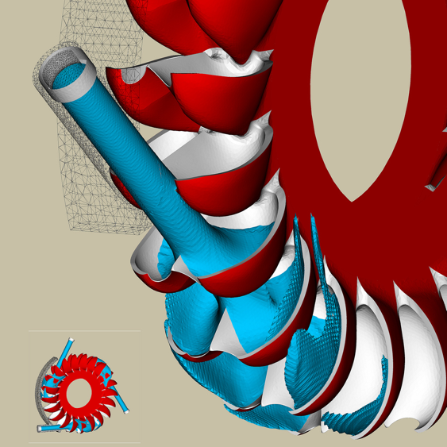
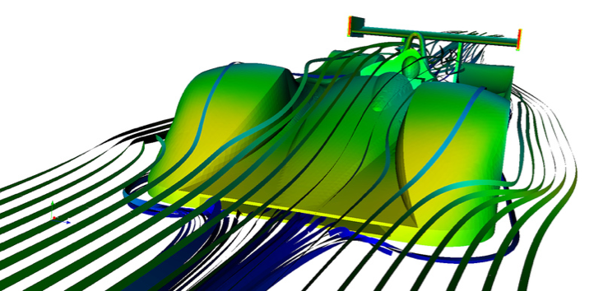
Jerry Clarke, US Army Research Laboratory
Swiss National Supercomputing Centre
Swiss National Supercomputing Centre
Renato N. Elias, NACAD/COPPE/UFRJ, Rio de Janerio, Brazil
Notes:
Small montage of projects using ParaView.
Demonstrates the breadth of utility ParaView has.

Slide 7
1990’s
2000’s
2020’s
Before consumer market impacted graphics. Single memory/multipipe machines (SGI)
2005: Specialized Vis cluster - Distributed memory, commodity clusters tightly coupled with compute platform.
Specialized HW (graphics cards, I/O, memory)
2010: Distributed memory capability clusters – ‘Running on the platform’
Highly constrained memory, no specialized HW
Constrained by power
Need: Coupled analysis
Exascale breaks everything
New programming models
Billion-way parallelism
RedRoSE/BlackRoSE
Exascale
Platform
Cielo
Notes:
That brings us about to where we are today.
As we move to petascale (10¹⁵ FLOPS) and on to exascale (10¹⁸ FLOPS) we face new challenges.
Our bottlenecks flip (FLOPS are free!) and the very von Neumann architecture brakes down.

Slide 8
Slide of Doom
 | 2010 | “2018” | Factor Change
System Peak | 2 Pf/s | 1 Ef/s | 500
Power | 6 MW | 20 MW | 3
System Memory | 0.3 PB | 10 PB | 33
Node Performance | 0.125 Gf/s | 10 Tf/s | 80
Node Memory BW | 25 GB/s | 400 GB/s | 16
Node Concurrency | 12 cpus | 1,000 cpus | 83
Interconnect BW | 1.5 GB/s | 50 GB/s | 33
System Size (nodes) | 20 K nodes | 1 M nodes | 50
Total Concurrency | 225 K | 1 B | 4,444
Storage | 15 PB | 300 PB | 20
Input/Output bandwidth | 0.2 TB/s | 20 TB/s | 100
DOE Exascale Initiative Roadmap, Architecture and Technology Workshop, San Diego, December, 2009.
Reported in The Opportunities and Challenges of Exascale Computing, Summary Report of the ASCAC Subcommittee, Fall 2010.
Notes:
If you’ve gone to several exascale talks, you’ve eventually seen a slide like this.
For those who haven’t, now you have.
It’s affectionately known as the slide of doom.
It predicts how the exascale architecture will differ from the current architecture.
It tells us how we are screwed at exascale.

Slide 9
Slide of Doom
 | 2010 | “2018” | Factor Change
System Peak | 2 Pf/s | 1 Ef/s | 500
Power | 6 MW | 20 MW | 3
System Memory | 0.3 PB | 10 PB | 33
Node Performance | 0.125 Gf/s | 10 Tf/s | 80
Node Memory BW | 25 GB/s | 400 GB/s | 16
Node Concurrency | 12 cpus | 1,000 cpus | 83
Interconnect BW | 1.5 GB/s | 50 GB/s | 33
System Size (nodes) | 20 K nodes | 1 M nodes | 50
Total Concurrency | 225 K | 1 B | 4,444
Storage | 15 PB | 300 PB | 20
Input/Output bandwidth | 0.2 TB/s | 20 TB/s | 100
DOE Exascale Initiative Roadmap, Architecture and Technology Workshop, San Diego, December, 2009.
Reported in The Opportunities and Challenges of Exascale Computing, Summary Report of the ASCAC Subcommittee, Fall 2010.
Notes:
What drives all exascale design is power.
We have power budget of 20MW.
Practical constraint. Hard to provide more power than that. Already takes a significant fraction of power station.
Expensive. Operating cost ~1 million $ per year per MW. Can’t afford to run more than 20 MW.
So the trick is to get a 500-1000X speedup with only a 3X increase in power.
Causes disparity on other system components.

Slide 10
Slide of Doom
 | 2010 | “2018” | Factor Change
System Peak | 2 Pf/s | 1 Ef/s | 500
Power | 6 MW | 20 MW | 3
System Memory | 0.3 PB | 10 PB | 33
Node Performance | 0.125 Gf/s | 10 Tf/s | 80
Node Memory BW | 25 GB/s | 400 GB/s | 16
Node Concurrency | 12 cpus | 1,000 cpus | 83
Interconnect BW | 1.5 GB/s | 50 GB/s | 33
System Size (nodes) | 20 K nodes | 1 M nodes | 50
Total Concurrency | 225 K | 1 B | 4,444
Storage | 15 PB | 300 PB | 20
Input/Output bandwidth | 0.2 TB/s | 20 TB/s | 100
DOE Exascale Initiative Roadmap, Architecture and Technology Workshop, San Diego, December, 2009.
Reported in The Opportunities and Challenges of Exascale Computing, Summary Report of the ASCAC Subcommittee, Fall 2010.
Notes:
So let’s start with comparing the peak performance to the I/O bandwidth.
We see a 5x relative loss in performance in the I/O bandwidth.

Slide 11
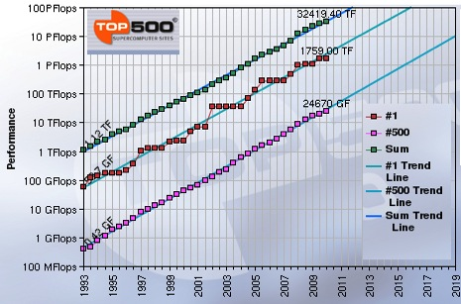
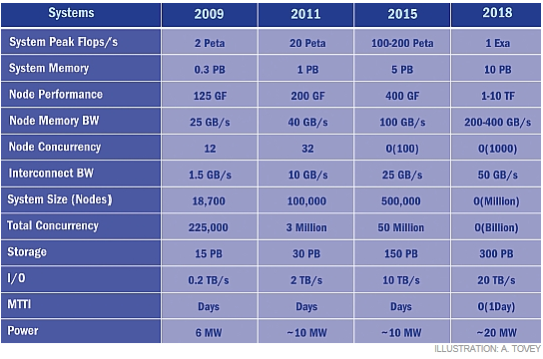
Extreme scale computing
Trends
More FLOPS
More concurrency
Comparatively less storage, I/O bandwidth
ASCI purple (49 TB/140 GB/s)
JaguarPF (300 TB/200 GB/s)
Most people get < 5 GB/sec at scale
From J. Dongarra, “Impact of Architecture and Technology for Extreme Scale on Software and Algorithm Design,” Cross-cutting Technologies for Computing at the Exascale, February 2-5, 2010.
Notes:
The I/O problem is not a new trend.
Been going on for a good 20 years.
Consider, for example, ASCI Purple and JaguarPF.
The difference in peak FLOPs went from 100 TF to 1 PF (10x).
Difference in peak I/O went up less than 50%.
In practice, you don’t even get anywhere near that.
The upshot is that you want to minimize the amount of disk access you do.

Slide 12
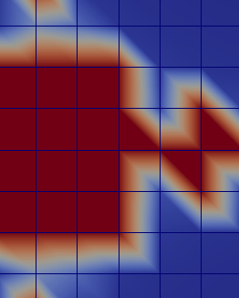
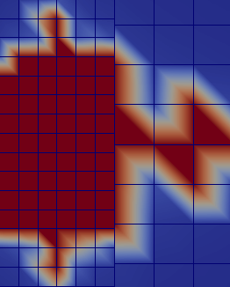
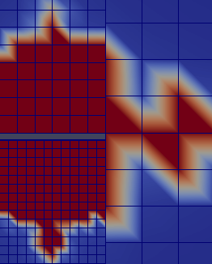
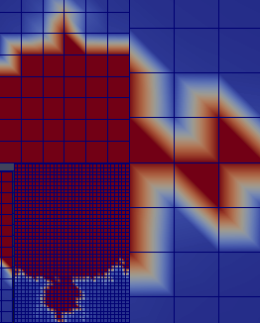
Prioritized Adaptive Streaming
Fine
Coarse
Notes:
One new technology we are pursuing to reduce I/O bandwidth is prioritized adaptive streaming.
Typically when visualizing with ParaView we start by loading all of the data from disk so it will be interactively available.
Can be a long time to wait.
With prioritized adaptive streaming, we don’t load all the data at once, or perhaps ever.
Rather than have a flat data set, we start with a hierarchical data set.
Top of hierarchy a coarse representation with progressive refinements as we go.
To start, we load a coarse representation of the data. Gives us quick overview.
As time passes we load progressive refinements.
Refinements are prioritized to give most important first.
For example, those visible and in front will be loaded first.

Slide 13
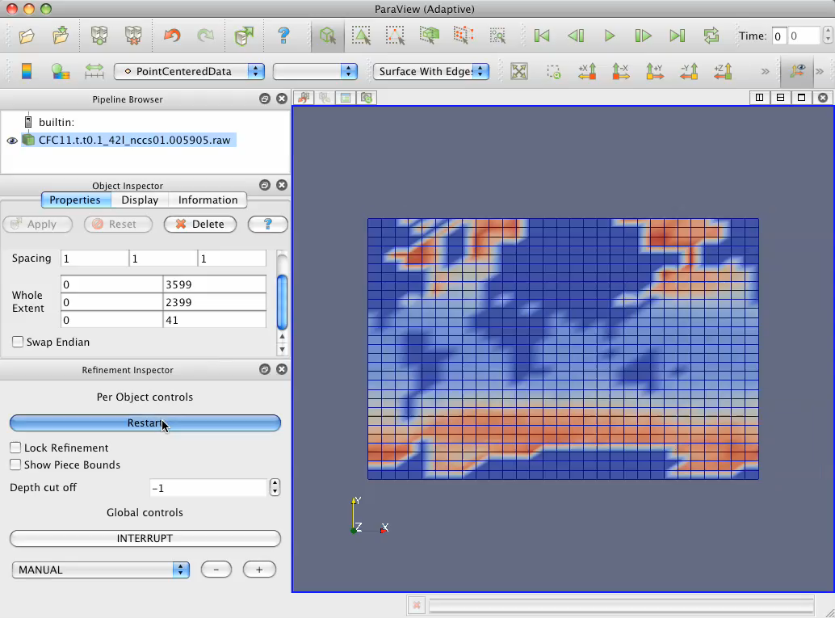

Slide 14
Diskless Visualization
Simulation
Simulation
Simulation
Full Mesh
Disk
Storage
Visualization
Features & Statistics
Images
Salient Data
Visualization
Disk
Storage
Disk
Storage
Visualization
Notes:
Adaptive streaming helps solve the problem from the visualization point of view, but possibly not from a holistic point of view.
Our post-processing visualization first requires a simulation to store its entire results to disk.
Lagging I/O times mean saving can take an inordinate amount of time.
May be difficult to archive all data on storage.

Slide 15
Diskless Visualization
Simulation
Simulation
Simulation
Full Mesh
Disk
Storage
Visualization
Features & Statistics
Images
Salient Data
Visualization
Disk
Storage
Disk
Storage
Visualization
Notes:
A way around this problem is to skip the disk entirely.
This can be done by coupling the visualization with the simulation, known as in situ visualization.
As the simulation runs, the visualization performs post processing on that data while it is still in memory.

Slide 16
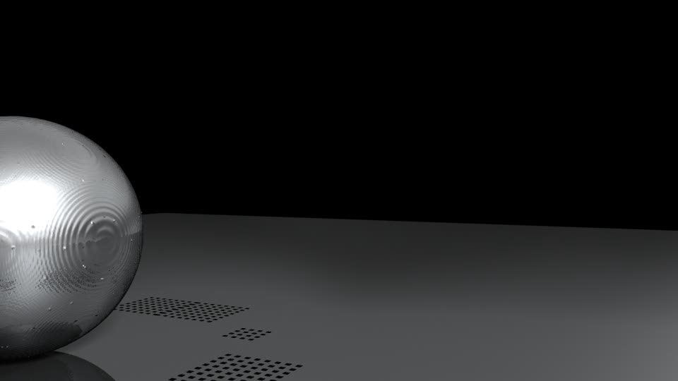
1 mesh per 100 steps
~1% write time
1 image per 1 step
~0.1% write time

Slide 17
Simulation
ParaView Coprocessing
Notes:
The intention and upshot is to embed the ParaView facilities in any simulation.

Slide 18
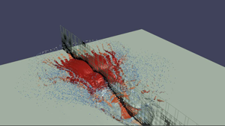
Simulation
ParaView Coprocessing
Output Processed Data
Rendered Images
Notes:
Nominally you will use that to create rendered images.

Slide 19
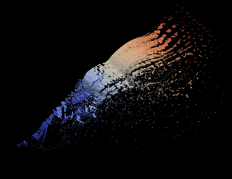
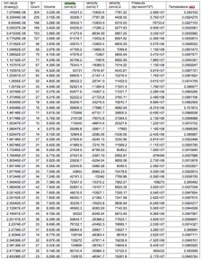
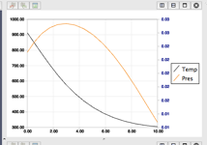
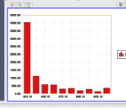
Simulation
ParaView Coprocessing
Output Processed Data
Polygonal Surfaces Field Data
Statistics
Line Series
Rendered Images
Notes:
But of course, ParaView is capable of so much more.
There are a variety of ways to process and analyze data.
Rather than rendering, what we really want is to move some of the analysis to the simulation and extract more information-rich data.

Slide 20
# Create the reader and set the filename.
reader = servermanager.sources.Reader(FileNames=path)
view = servermanager.CreateRenderView()
repr = servermanager.CreateRepresentation(reader, view)
reader.UpdatePipeline()
dataInfo = reader.GetDataInformation()
pDinfo = dataInfo.GetPointDataInformation()
arrayInfo = pDInfo.GetArrayInformation("displacement9")
if arrayInfo:
# get the range for the magnitude of displacement9
range = arrayInfo.GetComponentRange(-1)
lut = servermanager.rendering.PVLookupTable()
lut.RGBPoints = [range[0], 0.0, 0.0, 1.0,
range[1], 1.0, 0.0, 0.0]
lut.VectorMode = "Magnitude"
repr.LookupTable = lut
repr.ColorArrayName = "displacement9"
repr.ColorAttributeType = "POINT_DATA"
Simulation
Augmented script in input deck.
ParaView Coprocessing
Output Processed Data
Polygonal Surfaces Field Data
Statistics
Line Series
Rendered Images
Notes:
There are a variety of ways in which to specify what processing should be done.
The most flexible way to specify is to employ ParaView’s scripting capabilities.

Slide 21
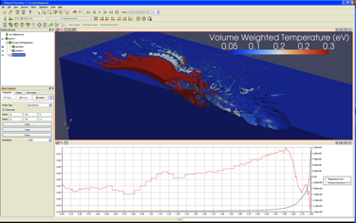
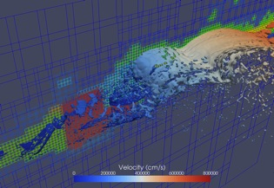
# Create the reader and set the filename.
reader = servermanager.sources.Reader(FileNames=path)
view = servermanager.CreateRenderView()
repr = servermanager.CreateRepresentation(reader, view)
reader.UpdatePipeline()
dataInfo = reader.GetDataInformation()
pDinfo = dataInfo.GetPointDataInformation()
arrayInfo = pDInfo.GetArrayInformation("displacement9")
if arrayInfo:
# get the range for the magnitude of displacement9
range = arrayInfo.GetComponentRange(-1)
lut = servermanager.rendering.PVLookupTable()
lut.RGBPoints = [range[0], 0.0, 0.0, 1.0,
range[1], 1.0, 0.0, 0.0]
lut.VectorMode = "Magnitude"
repr.LookupTable = lut
repr.ColorArrayName = "displacement9"
repr.ColorAttributeType = "POINT_DATA"
Simulation
Augmented script in input deck.
Script Export
ParaView Coprocessing
Output Processed Data
Polygonal Surfaces Field Data
Statistics
Line Series
Rendered Images
Notes:
And the easiest way to generate these scripts is to use the ParaView application itself.
With this we thus close the loop on the analysis.
With a proxy geometry, establish a visualization and export a script.
Use the script in a running simulation to generate extracted information.
Perform analysis on the extracted information, possibly with ParaView again.
Use the results to establish new visualizations for the next simulation.

Slide 22
Interactive Visualization
In-situ Library, Coupled with codes
Intrepid
(ANL)
Cielo
(LANL/SNL)
Red Sky
(SNL)

Slide 23
In Transit Visualization
Computation Nodes
Simulation
Simulation Results
Vis
Interactive Vis Controls
Staging
Nodes
Vis
Client
Visualization Results
Notes:
We can take this idea of loose coupling even farther: perform in transit (or staged) visualization.
Rather than couple our code directly with simulation, we use a third-party I/O library to transfer data.
The basic idea is as follows:

Slide 24
In Transit Visualization
Computation Nodes
Simulation
Simulation Results
Vis
Interactive Vis Controls
Staging
Nodes
Vis
Client
Visualization Results
Notes:
The simulation runs on the lion’s share of computation nodes.
Of course, simulation applications are just as concerned with file I/O costs as visualization applications.
Writes tend to be “bursty” when saving out large chunks of data for checkpoints or results.

Slide 25
In Transit Visualization
Computation Nodes
Simulation
Simulation Results
Vis
Interactive Vis Controls
Staging
Nodes
Vis
Client
Visualization Results
Notes:
Rather than stall the simulation, a frequently employed trick is to use staging nodes.
Instead of writing directly to disk, the simulation transfers data to the smaller staging job.
The staging nodes buffer and write the data while the simulation continues to the next iteration.
Often the staging nodes are allocated on special I/O nodes through which data has to pass anyway.
This is typically handled via an I/O library. To the simulation it looks like a synchronous write.
The processors in the staging nodes are pretty much idle the whole time.
Good opportunity to do some post-processing.
So… why not run your visualization algorithm on the staging nodes you have allocated anyway?

Slide 26
In Transit Visualization
Computation Nodes
Simulation
Simulation Results
Vis
Interactive Vis Controls
Staging
Nodes
Vis
Client
Visualization Results
Notes:
You could run a batch visualization and output the results of the visualization to disk.
Those results are generally significantly smaller than the original data.

Slide 27
In Transit Visualization
Computation Nodes
Simulation
Simulation Results
Vis
Interactive Vis Controls
Staging
Nodes
Vis
Client
Visualization Results
Notes:
Or we could interactively connect to the staging nodes and perform visualization from a client.
Or of course, you could do both at the same time.
Several advantages:
Those I/O guys know what they’re doing.
From both simulation and visualization perspective, I/O not much different than file access. Easer to implement and support.
The I/O library has a much smaller footprint for the simulation.
Of course, you need to schedule another job on another set of nodes

Slide 28
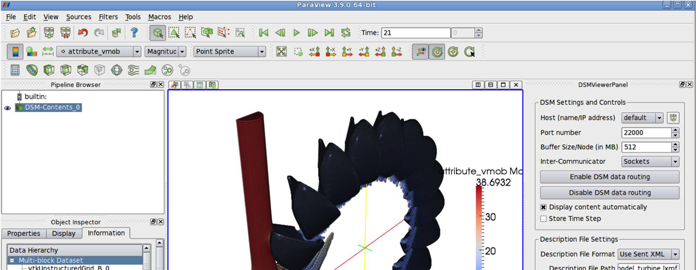
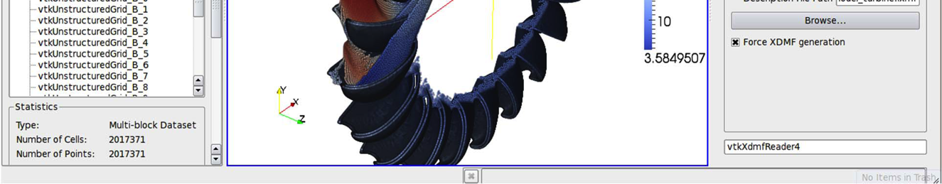
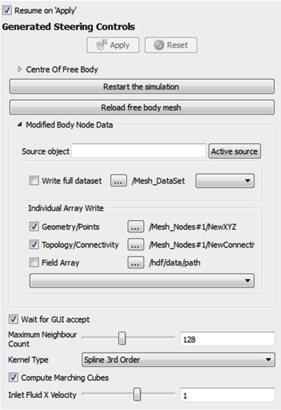
John Biddiscombe’s stuff
<DataExportProperty name="ModifiedBodyNodes"
command="SetSteeringArray"
label="Modified Body Node Data">
<DataExportDomain name="data_export"
full_path="/Mesh_DataSet"
geometry_path="/Mesh_Nodes#1/NewXYZ"
topology_path="/Mesh_Nodes#1/NewCo..."
command_property="ReloadFreeBodyMesh" />
</DataExportProperty>
Biddiscombe, et al, “Parallel Computational Steering and Analysis for HPC Applications using a ParaView Interface and the HDF5 DSM Virtual File Driver.”
Notes:
There are numerous examples of this in transit analysis. Here is an example that comes from the Swiss National Supercomputing Centre.
In this example the simulation writes out to the HDF5 library with a virtual file extension.
Instead of to disk, the data gets sent to a running ParaView server instance.
Can provide batch computing or interactive visualization.
Through extensions, can also provide feedback for simulation steering.
A ParaView plugin can dynamically read XML to customize GUI and controls for running simulation.

Slide 29
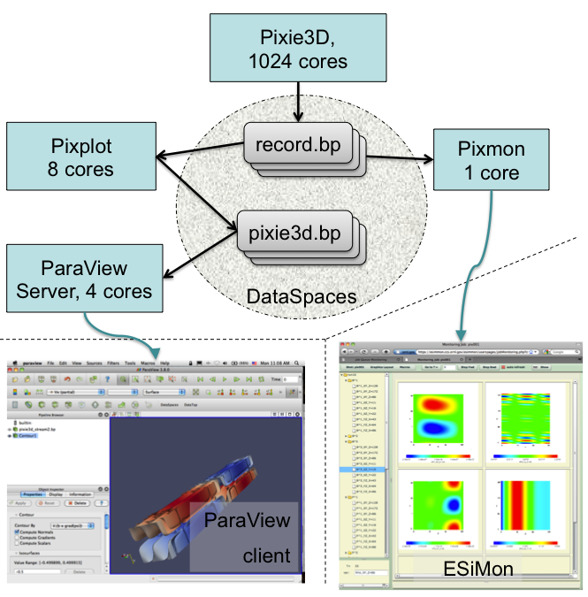
Notes:
Another great thing about in transit: not limited to simple simulation/visualization interface.
Can create a federated environment of loosely-coupled tools working together.
Provided proof of concept last year with a simulation working with two post-processing tools and ParaView server.
EXPLAIN WHAT IS GOING ON.
None of these tools were directly away of each other.
Hope to expand and harden this capability in the near future.

Slide 30
Slide of Doom
 | 2010 | “2018” | Factor Change
System Peak | 2 Pf/s | 1 Ef/s | 500
Power | 6 MW | 20 MW | 3
System Memory | 0.3 PB | 10 PB | 33
Node Performance | 0.125 Gf/s | 10 Tf/s | 80
Node Memory BW | 25 GB/s | 400 GB/s | 16
Node Concurrency | 12 cpus | 1,000 cpus | 83
Interconnect BW | 1.5 GB/s | 50 GB/s | 33
System Size (nodes) | 20 K nodes | 1 M nodes | 50
Total Concurrency | 225 K | 1 B | 4,444
Storage | 15 PB | 300 PB | 20
Input/Output bandwidth | 0.2 TB/s | 20 TB/s | 100
DOE Exascale Initiative Roadmap, Architecture and Technology Workshop, San Diego, December, 2009.
Reported in The Opportunities and Challenges of Exascale Computing, Summary Report of the ASCAC Subcommittee, Fall 2010.

Slide 31
Slide of Doom
 | 2010 | “2018” | Factor Change
System Peak | 2 Pf/s | 1 Ef/s | 500
Power | 6 MW | 20 MW | 3
System Memory | 0.3 PB | 10 PB | 33
Node Performance | 0.125 Gf/s | 10 Tf/s | 80
Node Memory BW | 25 GB/s | 400 GB/s | 16
Node Concurrency | 12 cpus | 1,000 cpus | 83
Interconnect BW | 1.5 GB/s | 50 GB/s | 33
System Size (nodes) | 20 K nodes | 1 M nodes | 50
Total Concurrency | 225 K | 1 B | 4,444
Storage | 15 PB | 300 PB | 20
Input/Output bandwidth | 0.2 TB/s | 20 TB/s | 100
DOE Exascale Initiative Roadmap, Architecture and Technology Workshop, San Diego, December, 2009.
Reported in The Opportunities and Challenges of Exascale Computing, Summary Report of the ASCAC Subcommittee, Fall 2010.

Slide 32
Naïve Scaling
 | 2010 | “2018” | Factor Change
System Memory | 0.3 PB | 10 PB | 33
Total Concurrency | 225 K | 1 B | 4,444
MPI Only?
Vis object code + state: 20MB
On Jaguar: 20MB × 200,000 processes = 4TB
On Exascale: 20MB × 1 billion processes = 20PB !
DOE Exascale Initiative Roadmap, Architecture and Technology Workshop, San Diego, December, 2009.
Reported in The Opportunities and Challenges of Exascale Computing, Summary Report of the ASCAC Subcommittee, Fall 2010.

Slide 33
Naïve Scaling
 | 2010 | “2018” | Factor Change
System Memory | 0.3 PB | 10 PB | 33
Total Concurrency | 225 K | 1 B | 4,444
Visualization pipeline too heavyweight?
On Jaguar: 1 trillion cells → 5 million cells/thread
On Exascale: 30 trillion cells → 30K cells/thread
DOE Exascale Initiative Roadmap, Architecture and Technology Workshop, San Diego, December, 2009.
Reported in The Opportunities and Challenges of Exascale Computing, Summary Report of the ASCAC Subcommittee, Fall 2010.

Slide 34
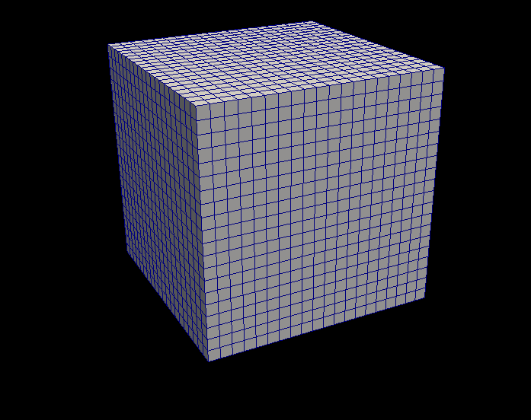
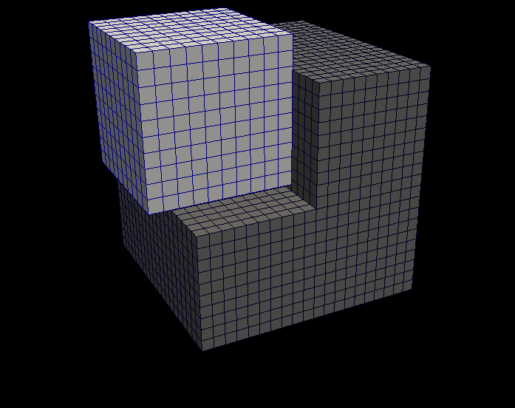
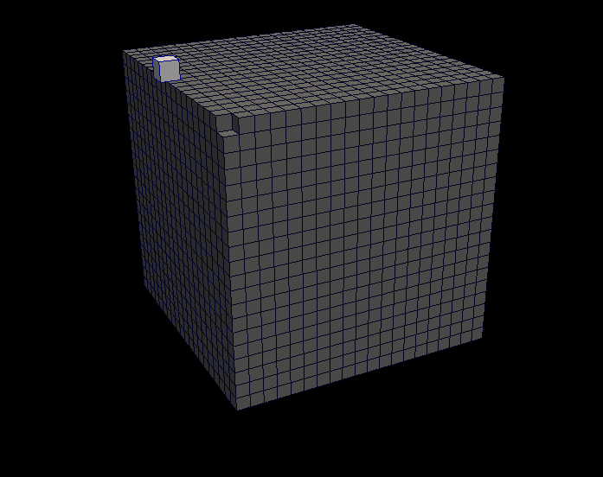
Revisiting the Pipeline
Lightweight Object
Serial Execution
No explicit partitioning
No access to larger structures
No state
Changing programming models
No communication
Filter
Notes:
Lightweight object: low overhead for indefinite parallelism.
Serial Execution: the point is to break the problem to its finest level and then run those units in parallel.
No explicit partitioning: cannot afford to divide data into pockets at this fine of a level and still capture connectivity.
No access to larger structures: remove possibility of race conditions, avoid complicated indexing semantics.
No state: private state quickly grows to a sizable chunk of overall memory and shared state opens up race conditions again.
Changing programming models: as new architectures form, our programming models are in flux.
Multi-core models: OpenMP, Threaded building blocks, pthreads.
GPU models: CUDA, OpenCL.
BTW, we don’t have exascale architectures today, but we feel GPUs are a pretty good analog.
Many threaded, custom memory hierarchies represent similar challenges.

Slide 35
Dax Makes it Easy
Templated to adapt to different cell structures.
int vtkCellDerivatives::RequestData(...)
{
...[allocate output arrays]...
...[validate inputs]...
for (cellId=0; cellId < numCells; cellId++)
{
...[update progress]...
input->GetCell(cellId, cell);
subId
= cell->GetParametricCenter(pcoords);
inScalars->GetTuples(cell->PointIds,
cellScalars);
scalars = cellScalars->GetPointer(0);
cell->Derivatives(subId,
pcoords,
scalars,
1,
derivs);
outGradients->SetTuple(cellId, derivs);
}
...[cleanup]...
}
template<class CellType>
DAX_WORKLET void CellGradient(...)
{
CellType cell = work.GetCell();
dax::Vector3 parametricCellCenter
= dax::make_Vector3(0.5, 0.5, 0.5);
dax::Vector3 value
= dax::exec::cellDerivative(
work,
cell,
parametricCellCenter,
points,
point_attribute);
work.SetFieldValue(cell_attribute, value);
}
Familiar vis structres (vectors, points, cells, coordinates).
Hazard-free data access.
Notes:
Here is an example of Dax hiding the programing model. This is actual code used in Dax to estimate a gradient in a cell.
We’ve compiled this code using CUDA and run on GPU.
Notice, no CUDA-specific language features. No special types or keywords. No triple chevron scheduling.
That’s all hidden in the framework. We an change it and leave the code the same.
In addition to hiding programming model idiosyncrasies, providing domain specific objects and operations.
Compare Dax code to VTK code. They look remarkably similar.
Regardless, this code gives about 100x speedup on GPU over single threaded CPU.
But that’s a poor comparison with a cherry picked problem.
Lots more interesting challenges in other algorithms.

Slide 36
Threaded Programming is Hard Example: Marching Cubes
Easy because cubes can be processed in parallel, right?
How do you resolve coincident points?
How do you capture topological connections?
How do you pack the results?
Notes:
The takeaway here is that the “reimplement components with threads” is not the easiest or best solution.
It may not even be viable.

Slide 37
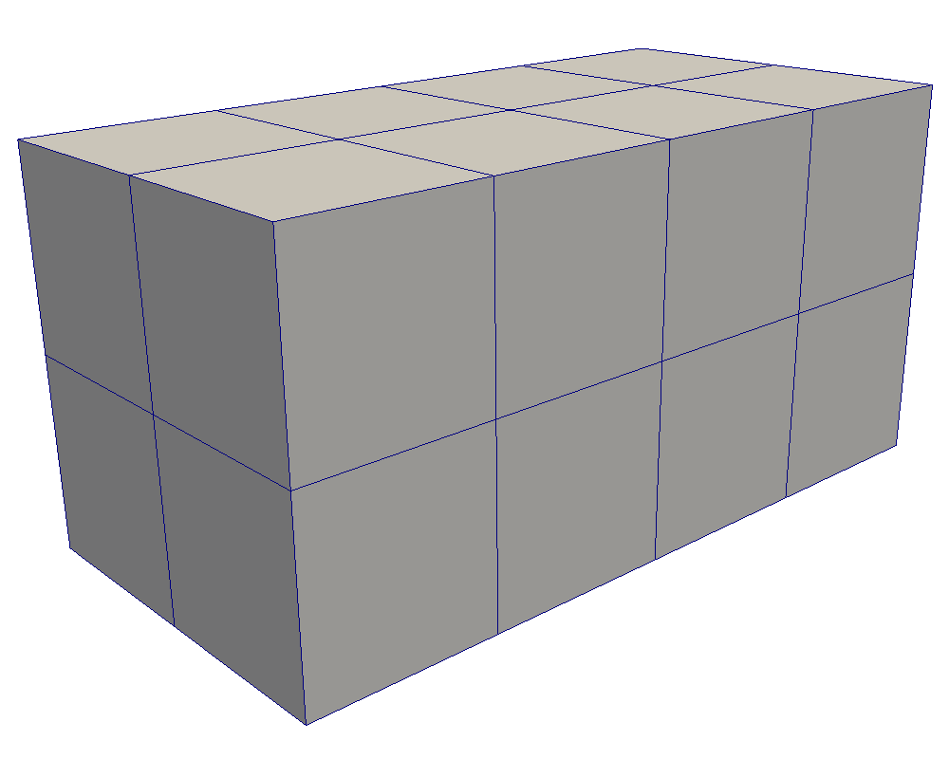
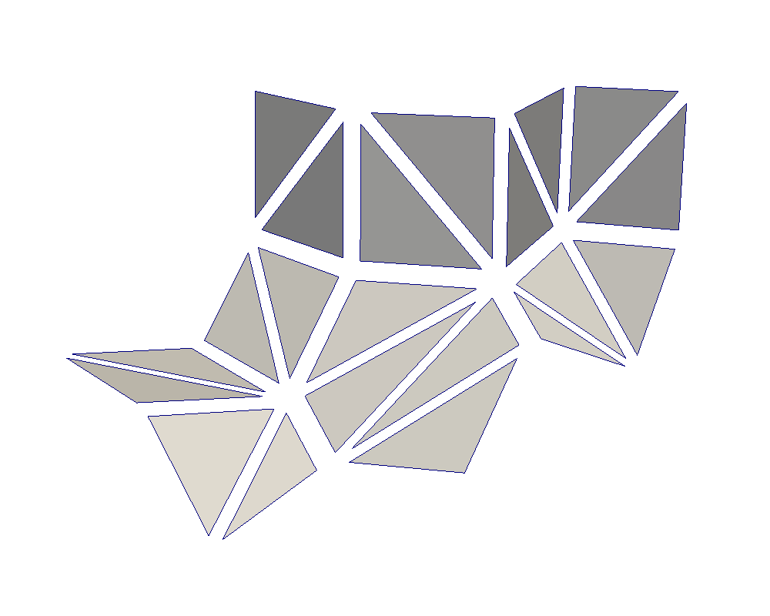
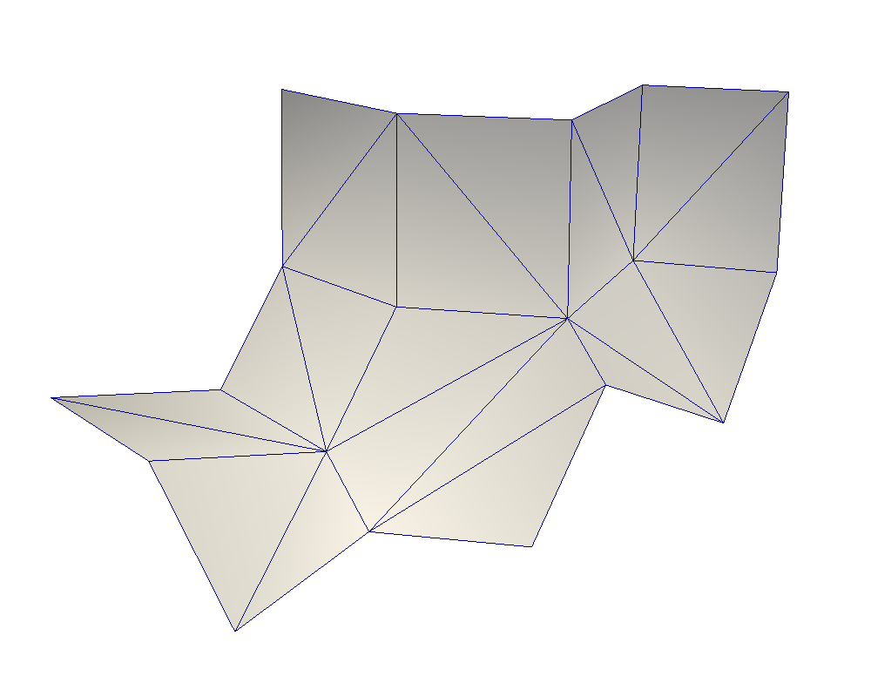
Work in Progress: Connectivity-Based Algorithms
Input Volume
Triangle Soup
Manifold Surface
Generate Triangles
(Local)
Connect Surface
(Communicative)
Notes:
Our current research is building connectivity for topology building algorithms.
The marching cubes example mentioned earlier fits in that category.
The easy part: generate geometry. Easily generate all primitives concurrently: no dependencies.
You end up with a “triangle soup.” All triangles represented independently.
Most (all) GPU algorithms end here. Probably OK if sent directly to rendering system.
If you store it: at least 4x the storage for repeated vertices.
Cannot perform connective analysis. (Simple example: smoothed normals.)
Need to resolve coincident vertices to represent manifold.
This is the “hard” part that we embed in Dax.

Slide 38
Dax: Vis on GPU and Beyond
Generate Triangles (Local)
Connect Surface (Communicative)
Templated to adapt to different cell structures.
template<class CellType>
DAX_WORKLET void CellGradient(...)
{
dax::Vector3 parametricCellCenter = dax::make_Vector3(0.5, 0.5, 0.5);
CellType cell = work.GetCell();
dax::Vector3 value = dax::exec::cellDerivative(work,
cell,
parametricCellCenter,
points,
point_attribute);
work.SetFieldValue(cell_attribute, value);
}
Familiar vis structures (vectors, points, cells, coordinates).
Hazard-free data access.
Notes:
Also leading the Dax project: funded under ASCR exascale
Intention: build a framework to simplify building deeply threaded, very efficient visualization algorithms.
Basic idea: separate out operations that are “local”, make them easy and safe to code, build them optimized for lightweight threads.
Provide efficient operations for basic visualization communicative operations.
Example w/ marching cubes, generate triangles vs. find connective surface.
Hide device-specific coding constructs for maximum portability.
Our current research is building connectivity for topology building algorithms.
The marching cubes example mentioned earlier fits in that category.

Slide 39
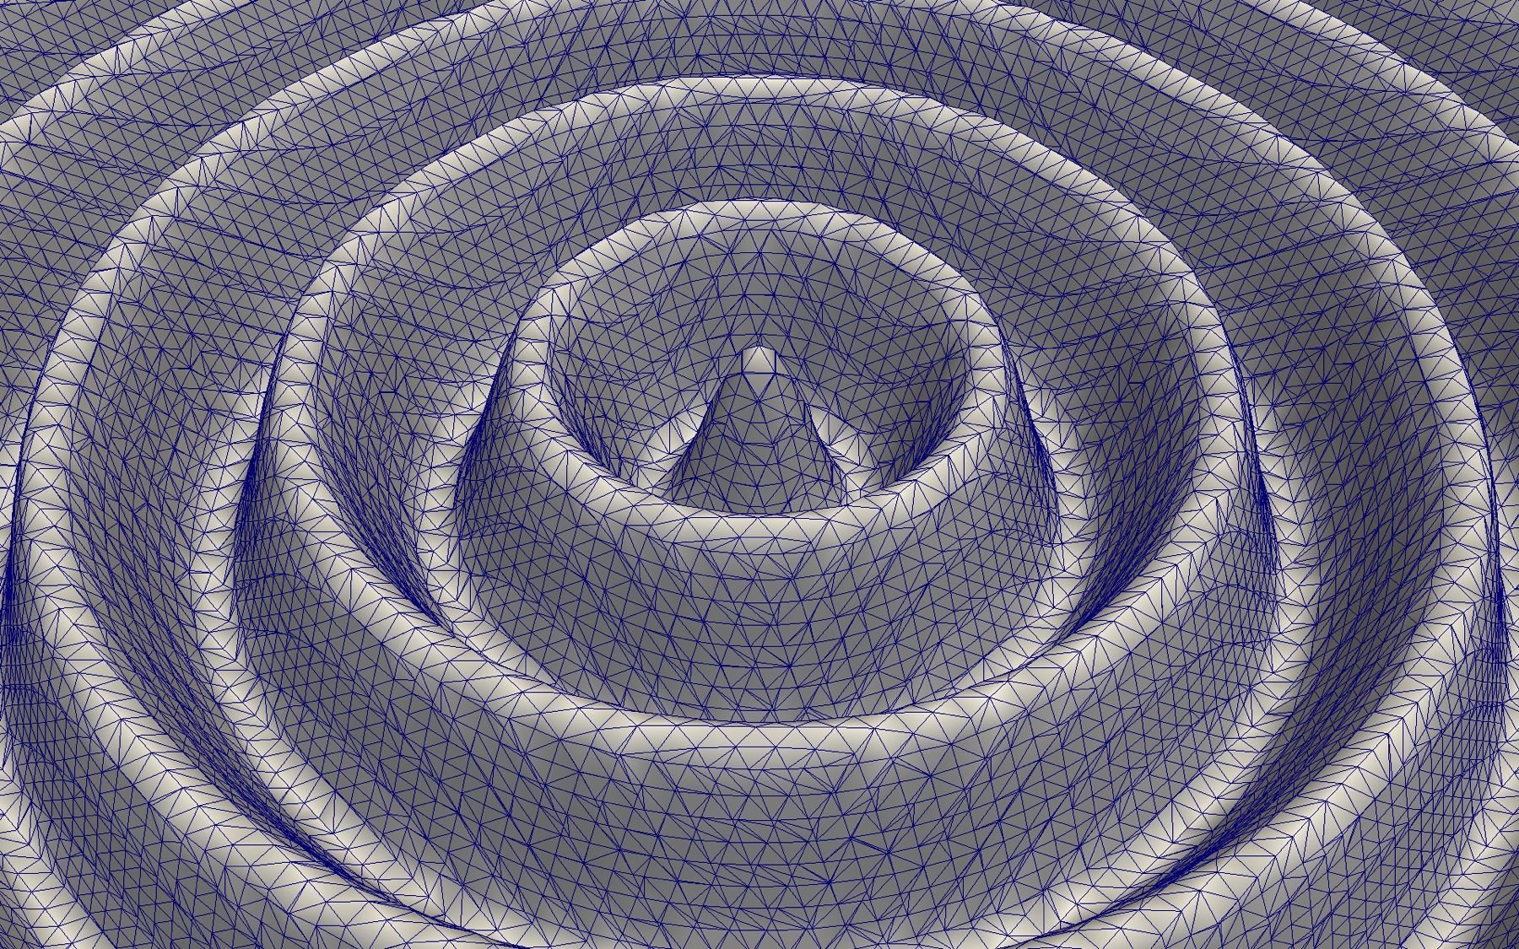
Notes:
Here is an instance of our marching cubes run on a GPU.
Hard to tell, but we are actually doing the coincident point resolution.
Even with this non-local operation, still running about 10x faster than VTK.
Allows us to do things like smooth the normals.
You may notice lots of weird artifacts caused by the marching cubes algorithm. Just the nature of how it works.
But, since we are finding coincident points anyway, why not also find nearby points.

Slide 40
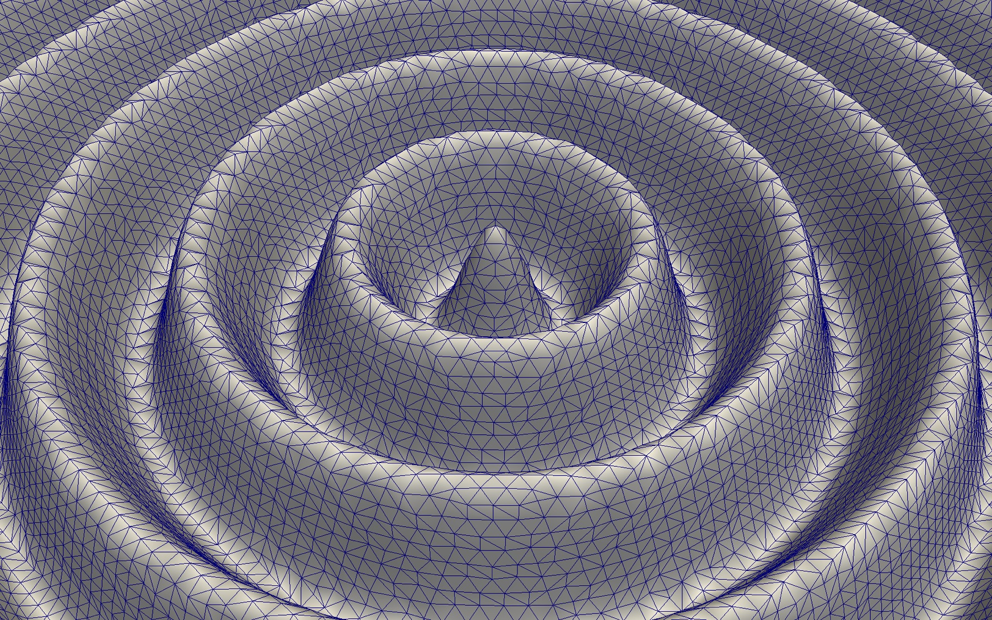
Notes:
Turns out our coincident point resolution provides a free mechanism to clean up the surface.
Don’t have time to go into details. (I’m making Rob fall asleep anyway.)
The really interesting part about the algorithm is that it costs no computational time.
In fact, it speeds up the algorithm.
It is interesting that the challenge of GPU computing lead to a new type of algorithm.
Show challenges bring opportunities.

Slide 41
Coarsened Triangle Quality
Notes:
As you can see by this plot, the algorithm does a really good job removing poor quality triangles.
The kept triangles are only moderately modified.

Slide 42
Coarsened Mesh Error

Slide 43
1990’s
2000’s
2020’s
Before consumer market impacted graphics. Single memory/multipipe machines (SGI)
2005: Specialized Vis cluster - Distributed memory, commodity clusters tightly coupled with compute platform.
Specialized HW (graphics cards, I/O, memory)
2010: Distributed memory capability clusters – ‘Running on the platform’
Highly constrained memory, no specialized HW
Constrained by power
Need: Coupled analysis
Exascale breaks everything
New programming models
Billion-way parallelism
RedRoSE/BlackRoSE
Exascale
Platform
Cielo
Questions?
Notes:
I conclude by observing we are facing our second revolutionary change in visualization.
First revolution moved from serial applications on special purpose workstations to clusters of commodity components.
Our second revolution moves us to tightly-integrated and massively-threaded visualization.

